Slide 1




TEAM 2
AST COMPANY
Prime
Estate
SALES ANALYSIS PROJECT

Slide 2



TEAM 2
AST
Agenda
Our Team | 3
About The Project | 4
Main Challenges and Analysis Objectives | 5
Points to Focus On | 6
Data Collection & Handling | 7
Mockups | 8
Tools | 9
Data Cleaning | 10
Data Visualization | 11
DAX | 13
Insights | 14

Slide 3





TEAM 2
AST
Zeinab Sharaf
Team Leader
Data Analyst & Engineer
Our
Team
Mennatallah Sayed
Member
Data Analyst & Engineer
Evrosina Amir
Member
Teaching assistant at Ain Shams University
Menna Nader
Member
Bancassurance protection at axa egypt
Nour Adel
Member
Pharmacist
Back to Agenda

Slide 4
TEAM 2
AST
About
The Project
About Dataset
An inventory database listing all projects, properties, cost, package price, current status, and sales date.
The project management database tracks the construction initiation, time lapsed till the project is at 90% completion, and another date that tags it at 100% completed.
The collections database includes a listing of all units that are tagged as sold and tracks the turnover date (the date that the unit was turned over to the owner), collection date (the date that the full amount was based on the package price and all other charges) was collected from the buyer through multiple channels.
Real Estate Database
This is a mock-up of a real estate company, this is based on an actual company that had a number of challenges - collection and revenue is the biggest issue.
A deep dive into the available data will provide the possible reasons and is the purpose of the data analytics project.
Back to Agenda

Slide 5








TEAM 2
AST
Main challenges
# 1
Collection and Revenue
Main
Challenges & Analysis Objectives
# 2
Buyers complain about delayed delivery of units or projects
# 3
Inconsistent sales performance
Back to Agenda

Slide 6



TEAM 2
AST
Analysis Objectives
# 1
Identify and analyze historical problems in the company's operations.
Main
Challenges & Analysis Objectives
# 2
Provide recommendations for improving performance in the areas of collection, project management and sales.
Back to Agenda

Slide 7

TEAM 2
AST
Points to Focus On
Collection:
MEASURING COLLECTION PERFORMANCE AND KNOWING THE EXTENT TO WHICH GOALS HAVE BEEN ACHIEVED
Project management:
TRACKING COMPLETION STAGES AND TIME ANALYSIS
Customer service:
DEALING WITH CUSTOMER COMPLAINTS AND IMPROVING SERVICE
Sales:
MEASURING SALES PERFORMANCE AND ANALYZING TRENDS
Back to Agenda

Slide 8
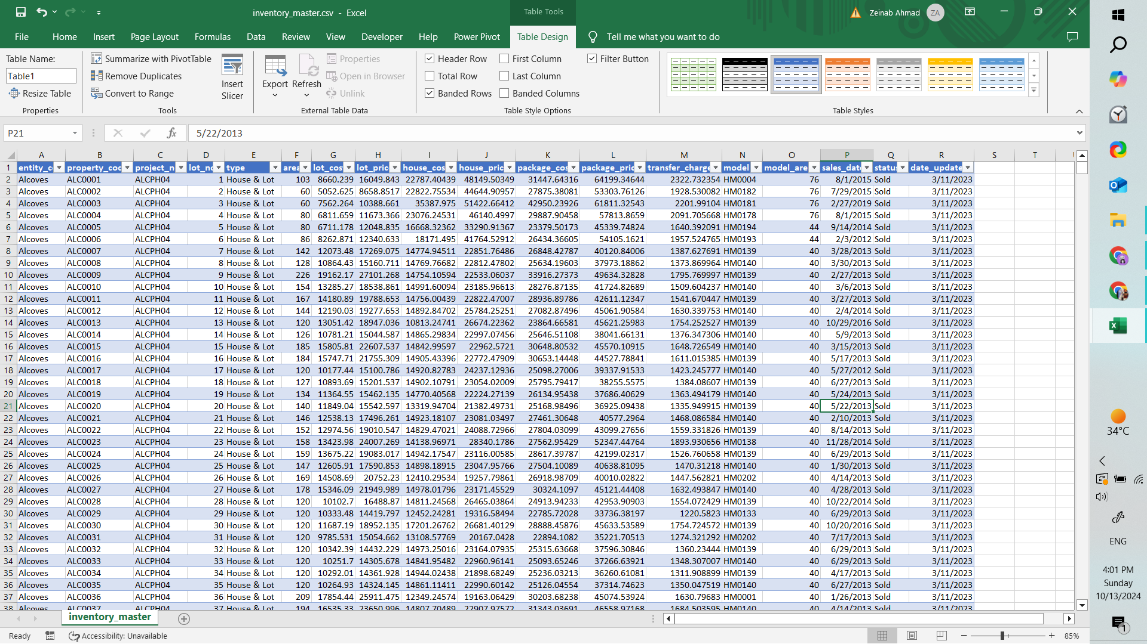
TEAM 2
AST
Data
Handling
Inventory Table
Tracks inventory information on projects and properties, including their costs and prices
MAIN COLUMNS
Back to Agenda

Slide 9
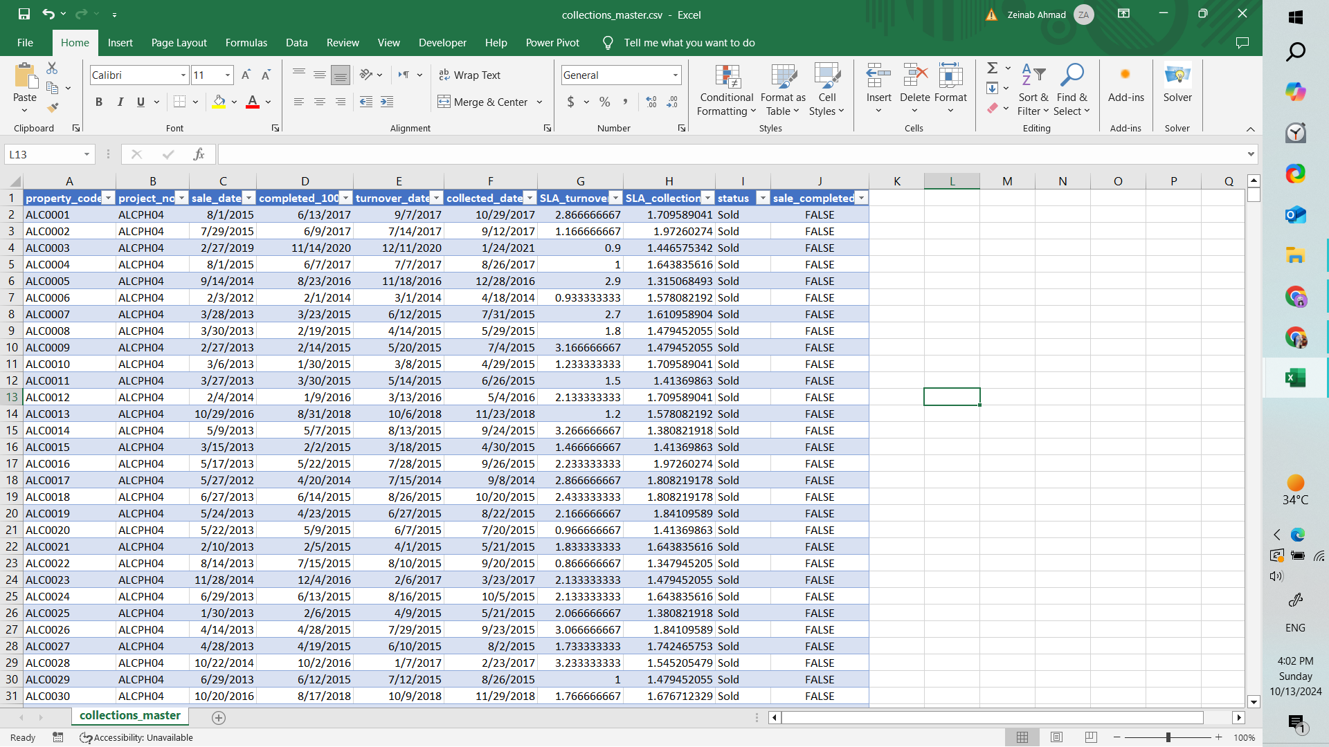
TEAM 2
AST
Data
Handling
Collection Table
Tracks collection information from sales.
MAIN COLUMNS
Back to Agenda

Slide 10
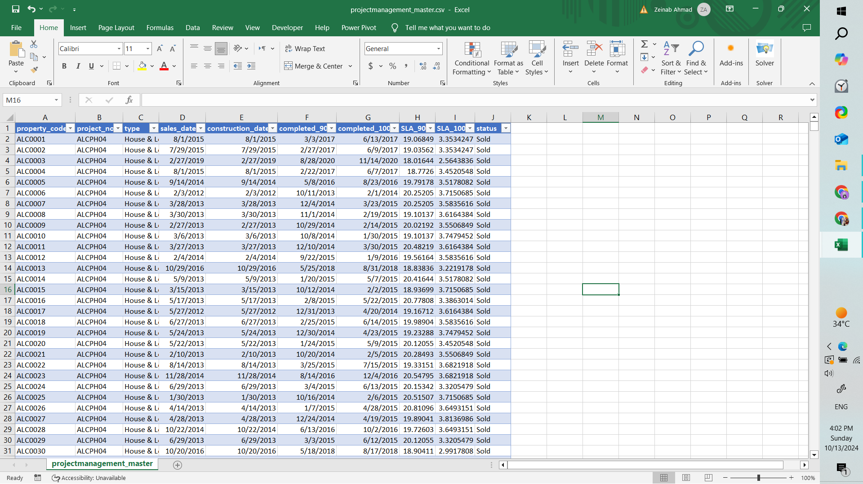
TEAM 2
AST
Data
Handling
Project Management Table
Tracks construction phases and monitors project progress
MAIN COLUMNS
Back to Agenda

Slide 11
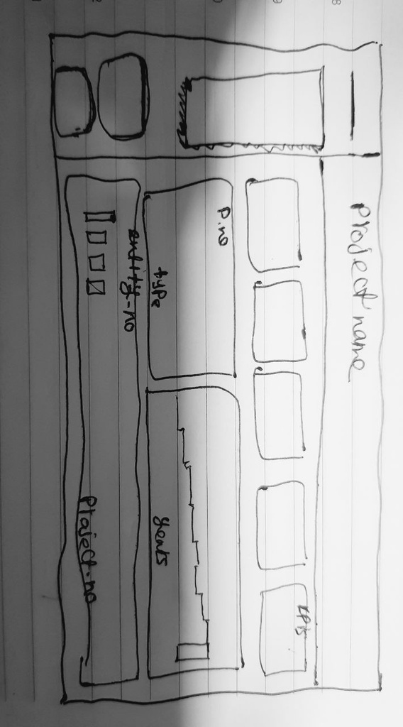
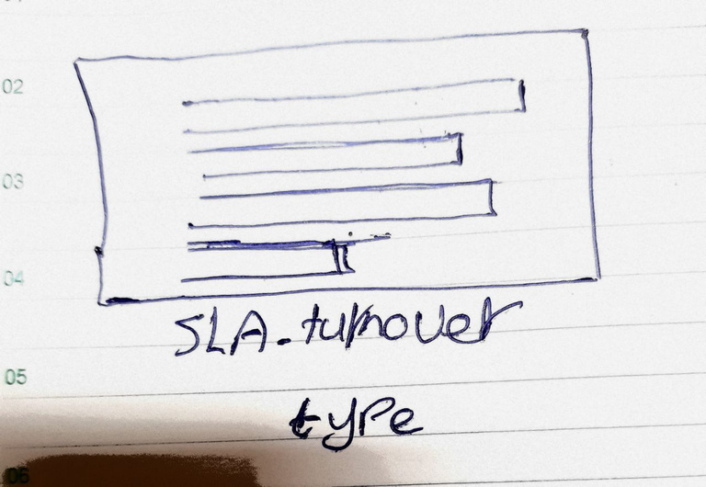
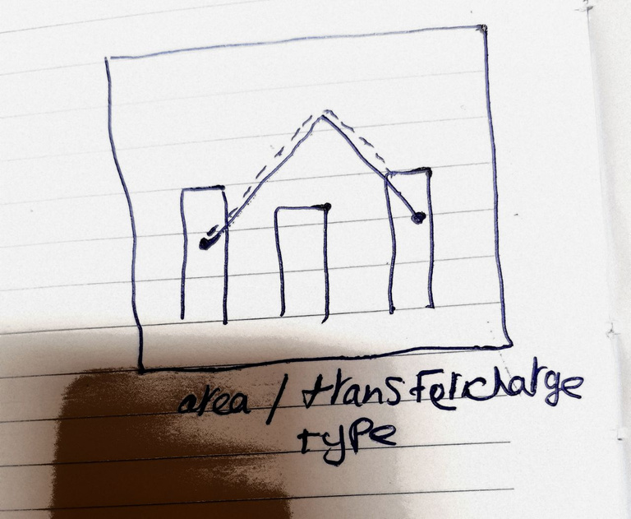
TEAM 2
AST
Mockups
Back to Agenda
Back to Agenda

Slide 12





TEAM 2
AST
Excel
.CSV files
Ms SQL Server
Data Cleaning
Tools
Power BI
Data Visualizagtion
Canva
Presentation
ChatGpt
AI Supporting
Back to Agenda

Slide 13

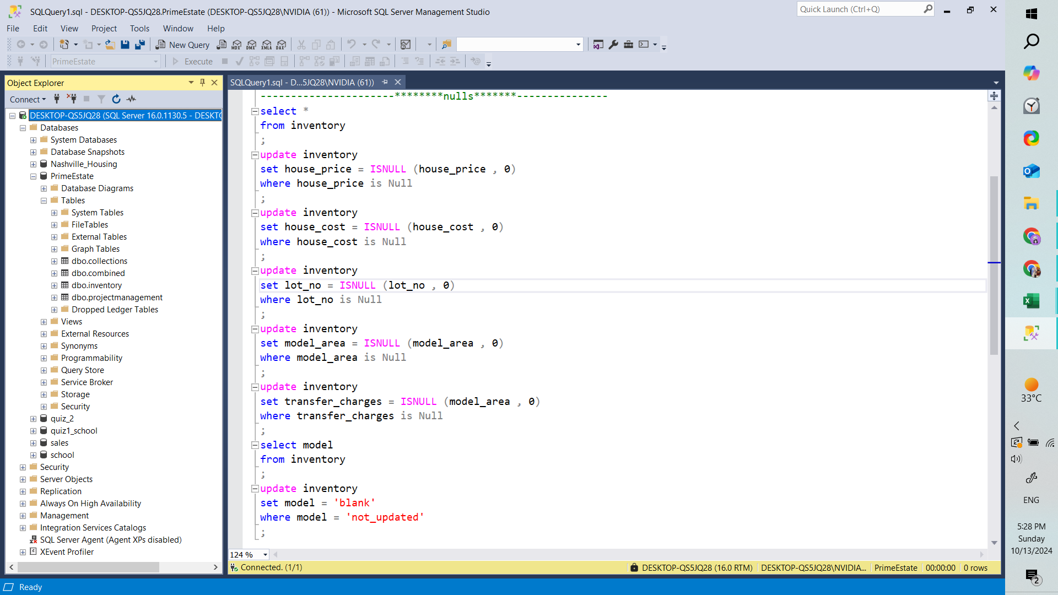
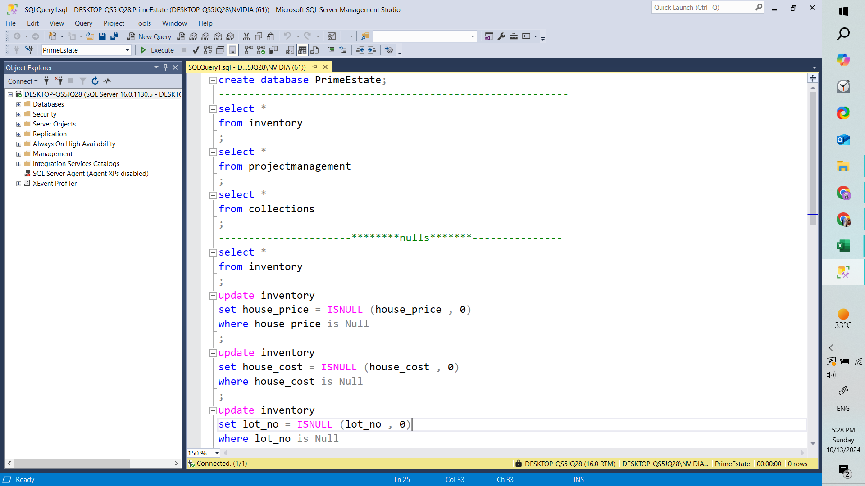
TEAM 2
AST
Data
Cleaning
Creating Database with Tabels
Back to Agenda

Slide 14
TEAM 2
AST
Data
Cleaning
Handling NULLS

Slide 15
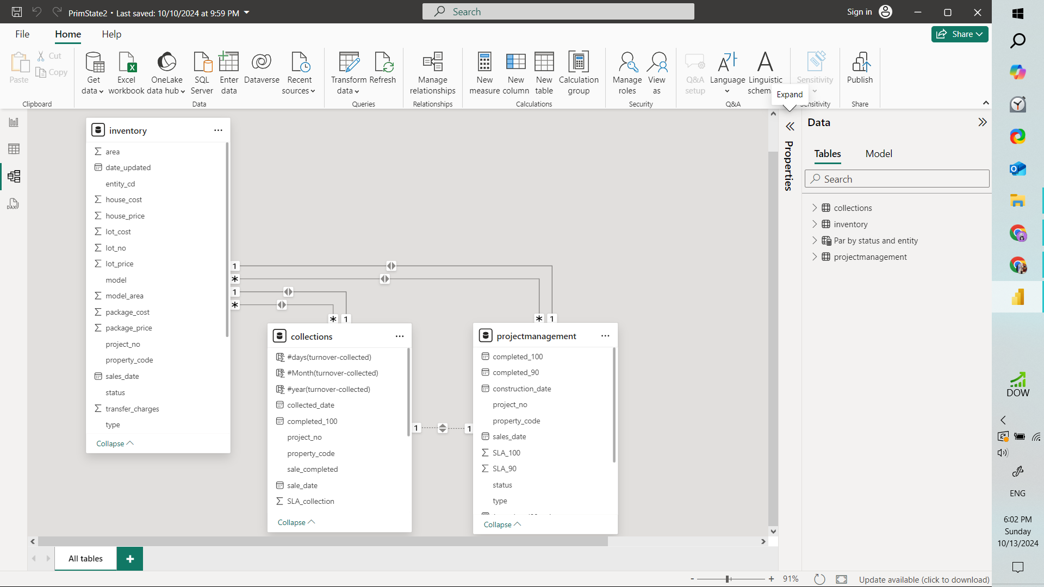
TEAM 2
AST
Data Modling
Back to Agenda

Slide 16
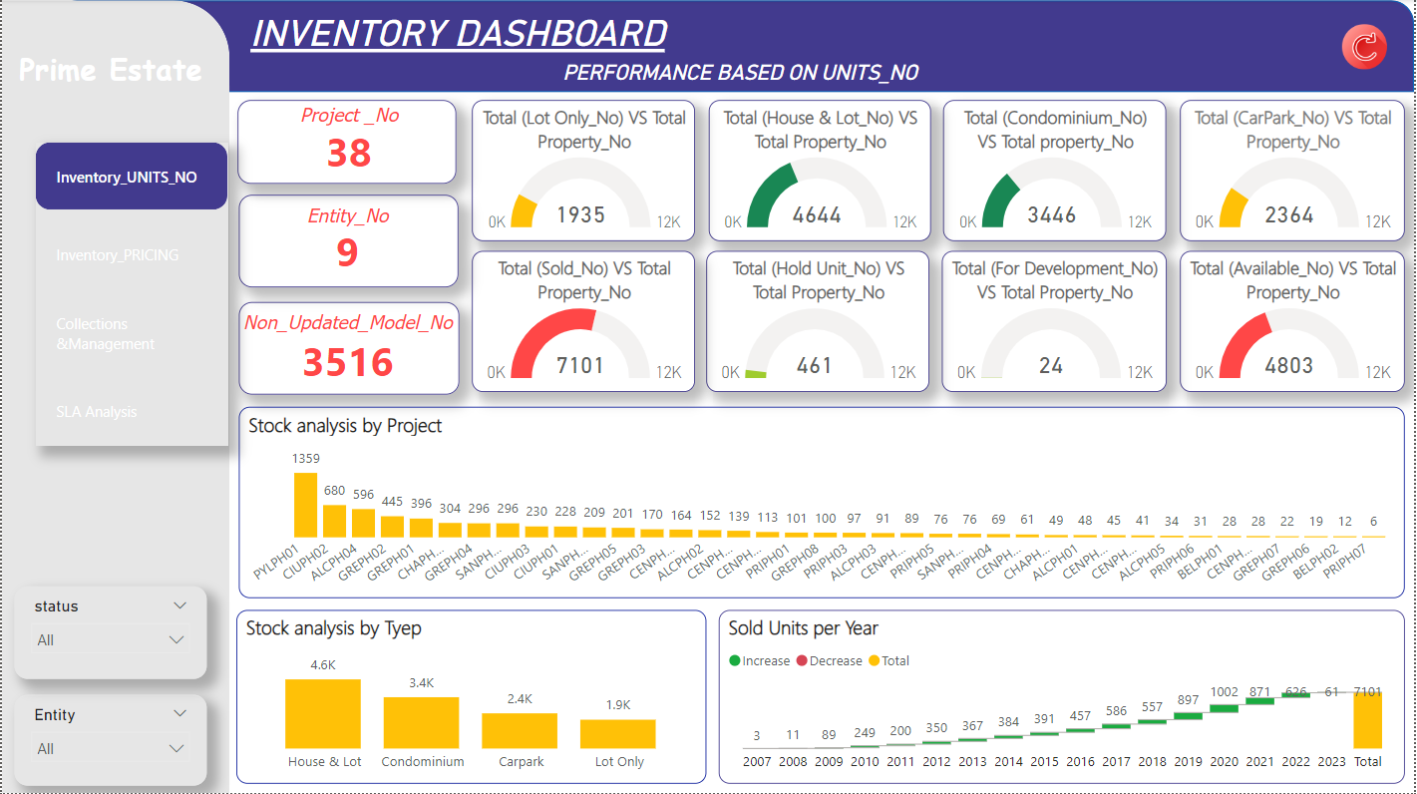
TEAM 2
AST
Data Visualization

Slide 17
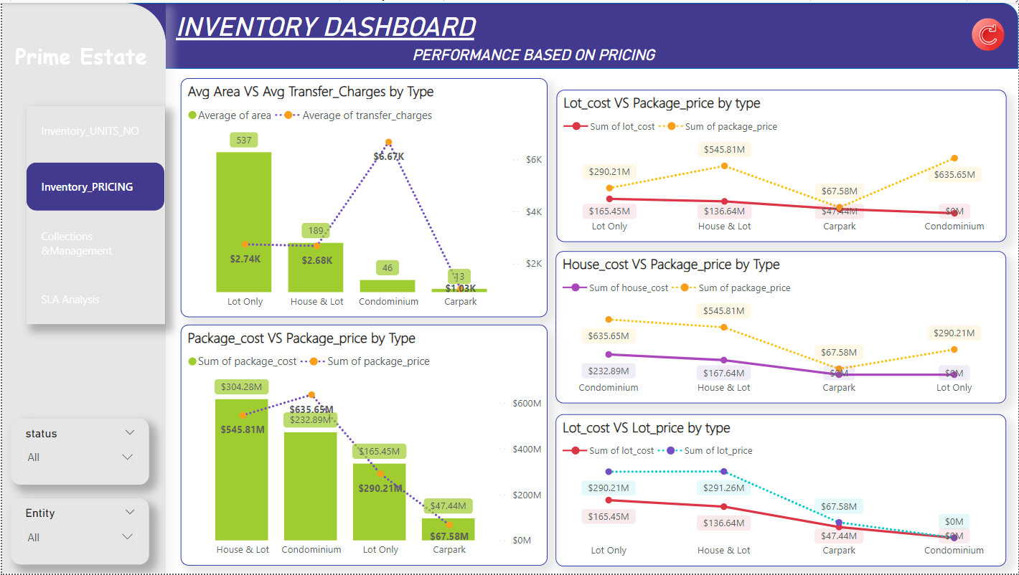
TEAM 2
AST
Data Visualization

Slide 18
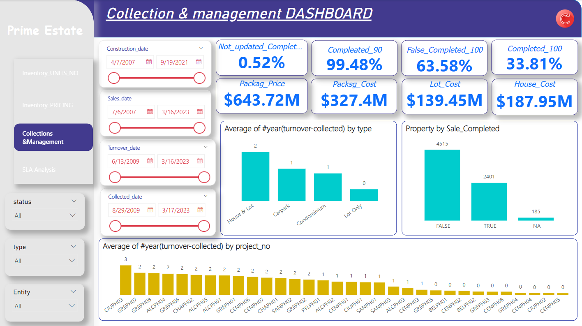
TEAM 2
AST
Data Visualization

Slide 19
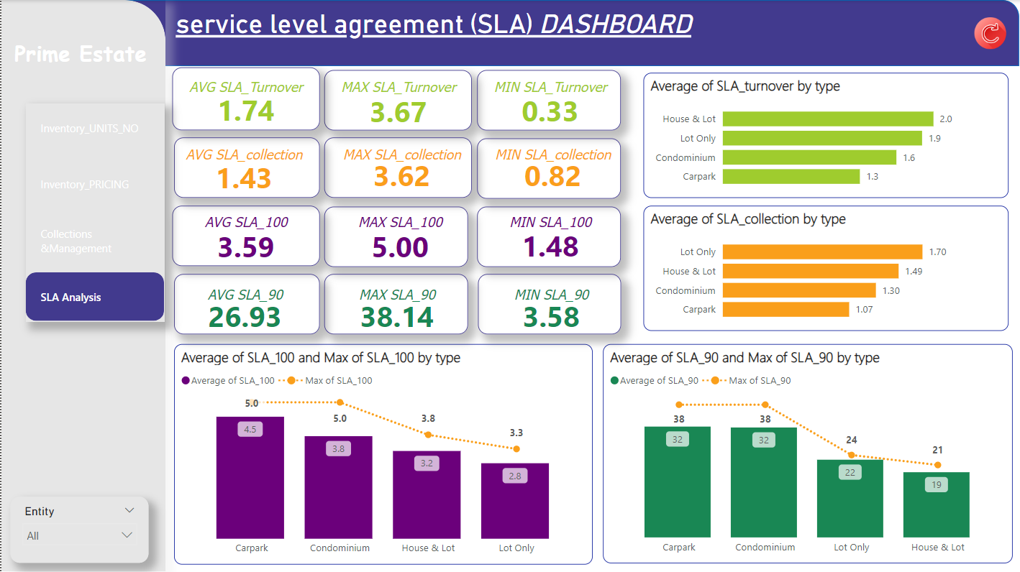
TEAM 2
AST
Data Visualization

Slide 20
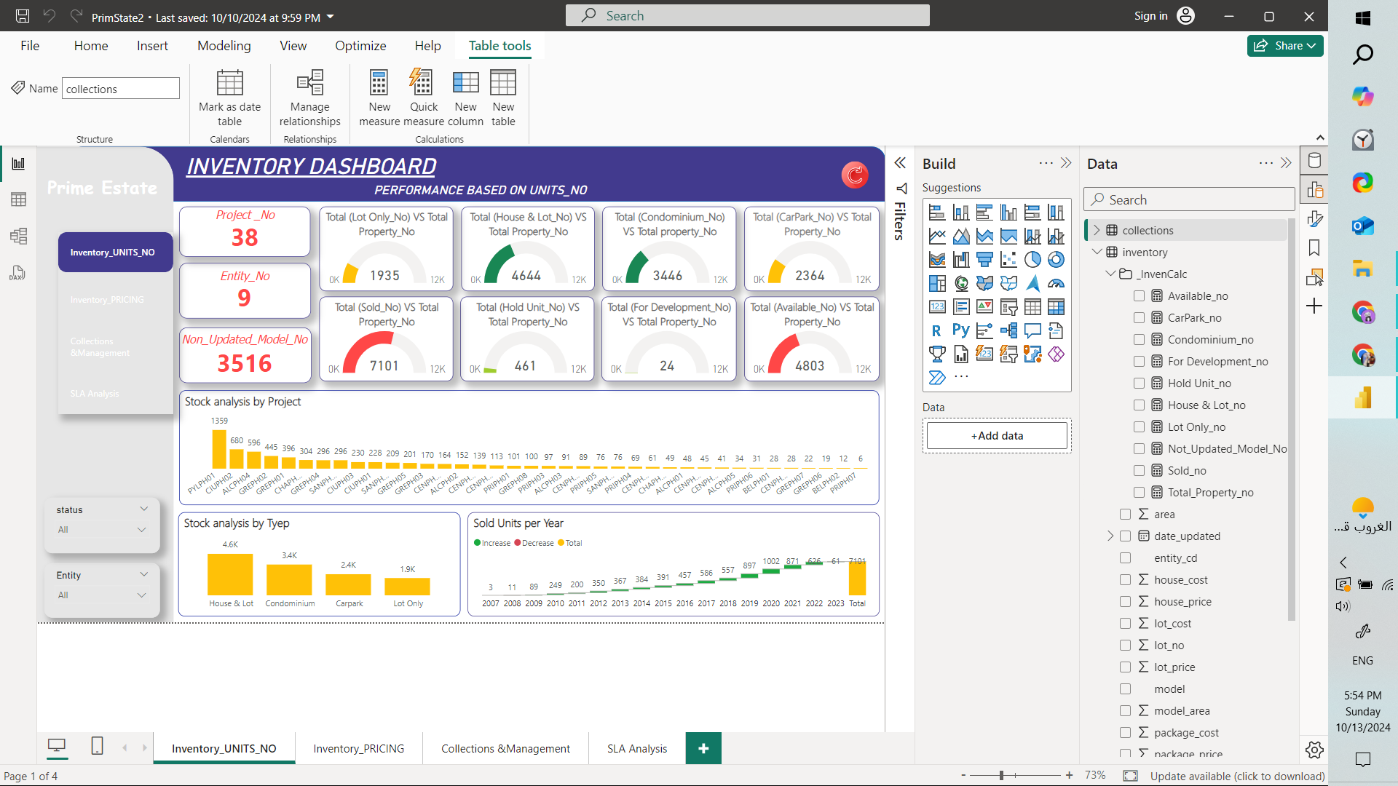
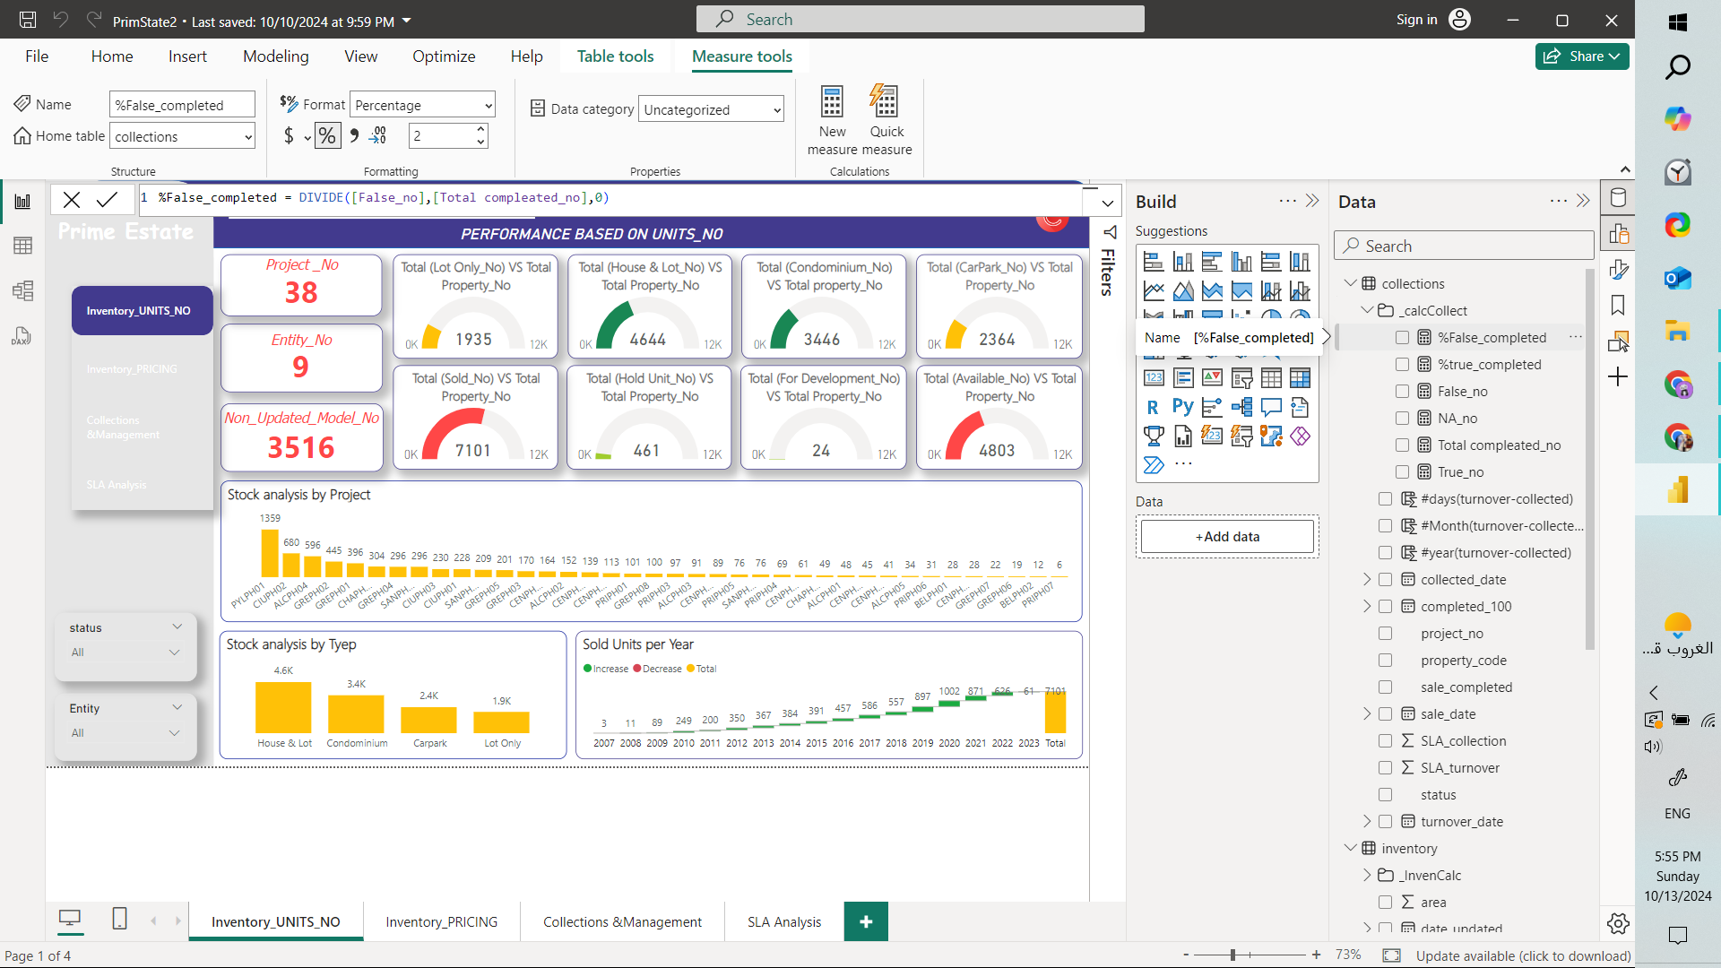
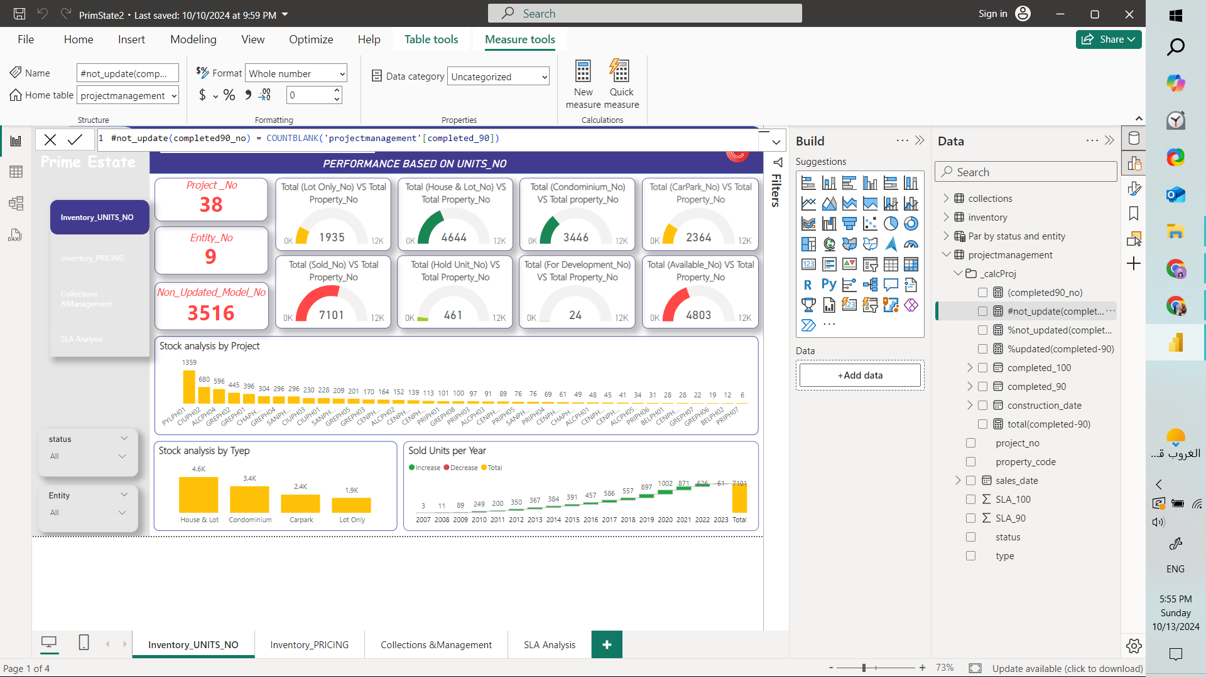
TEAM 2
AST
DAX

Slide 21
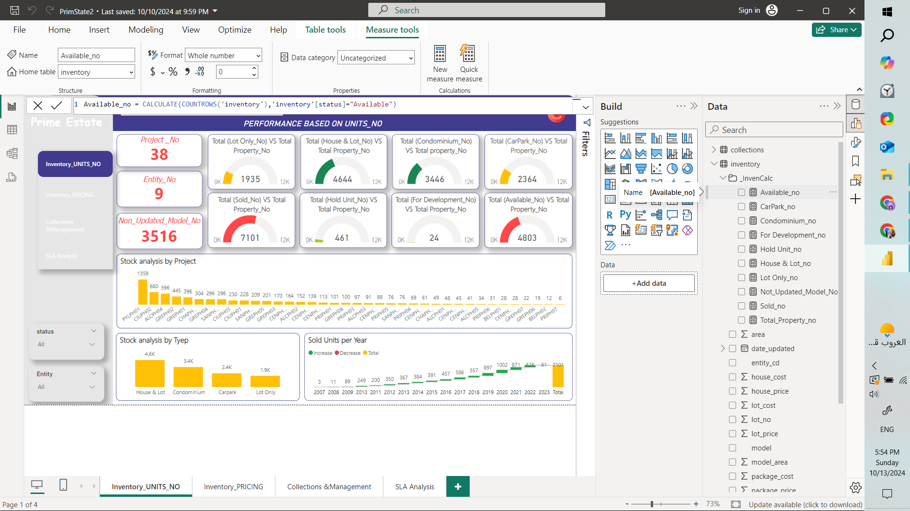

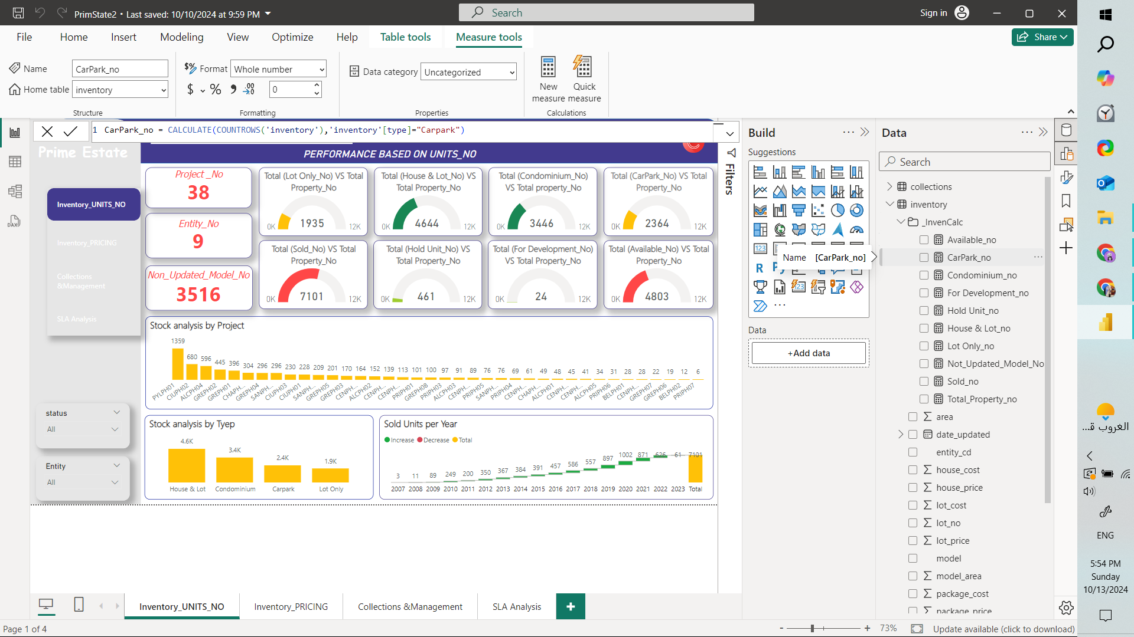
TEAM 2
AST
DAX
Aggregation

Slide 22
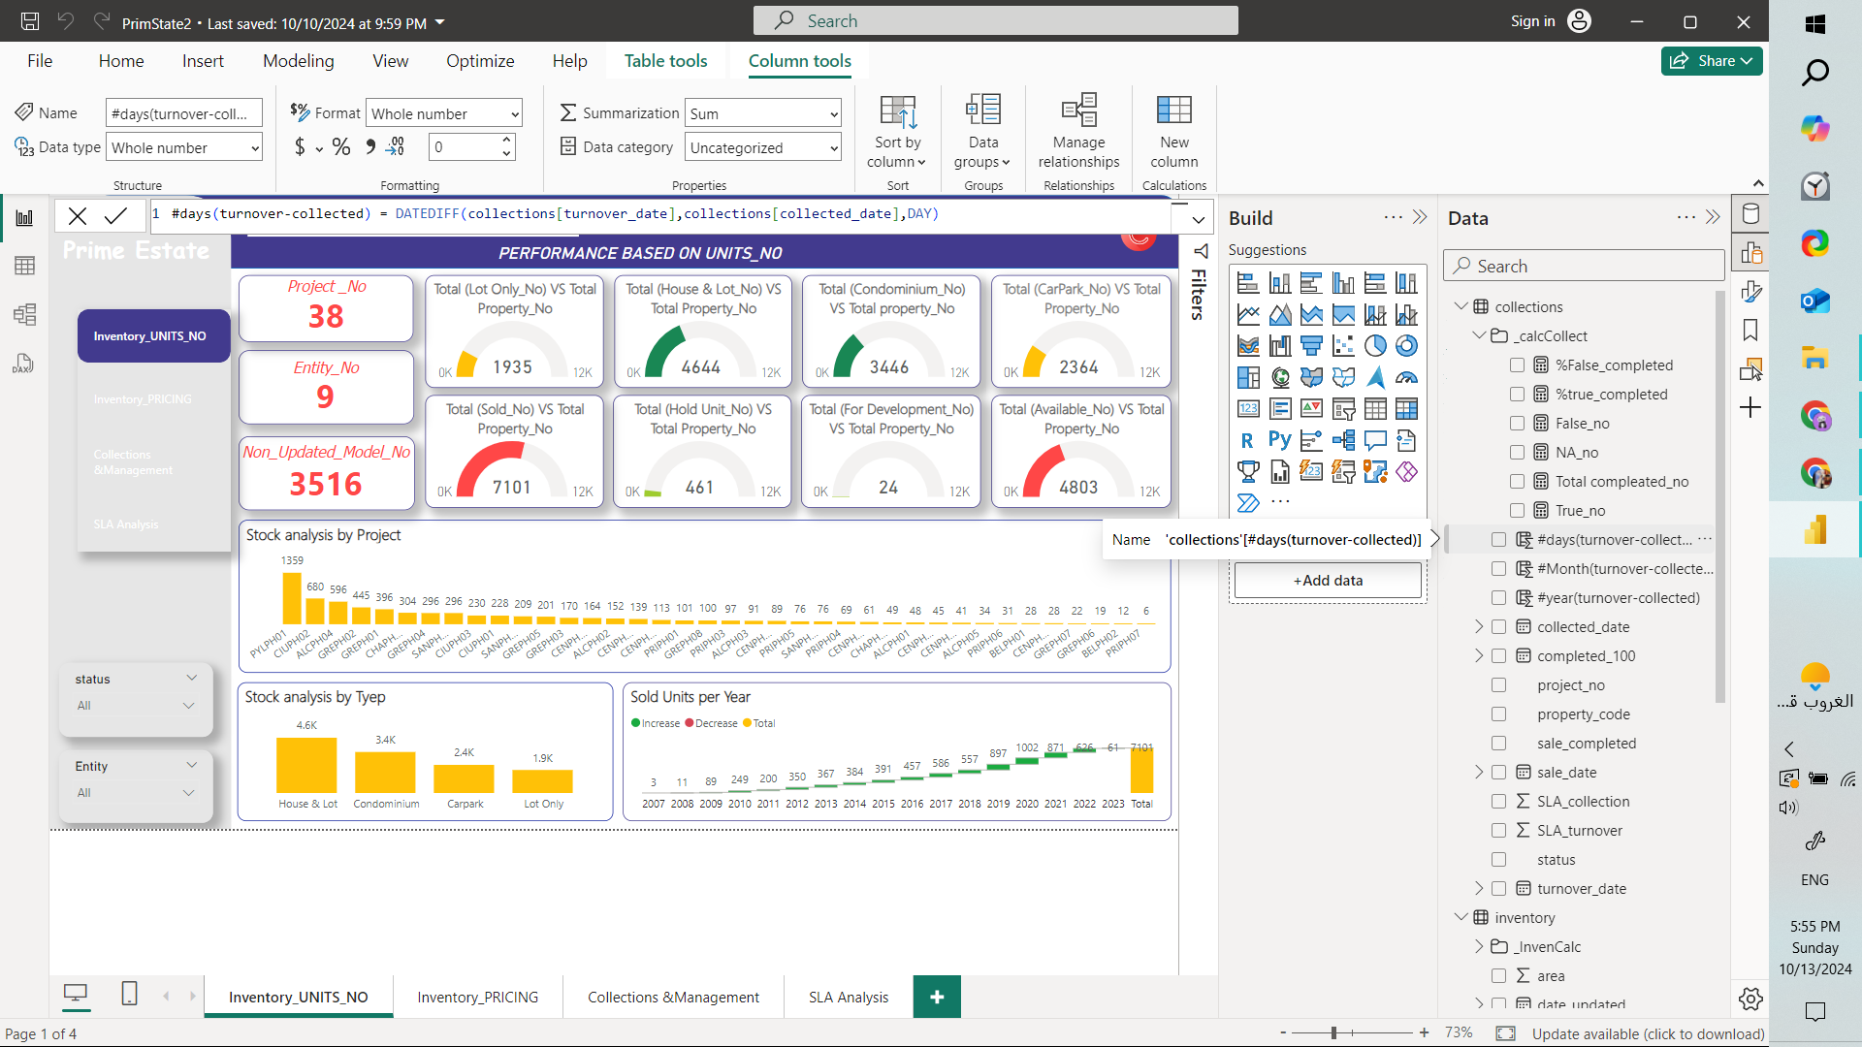
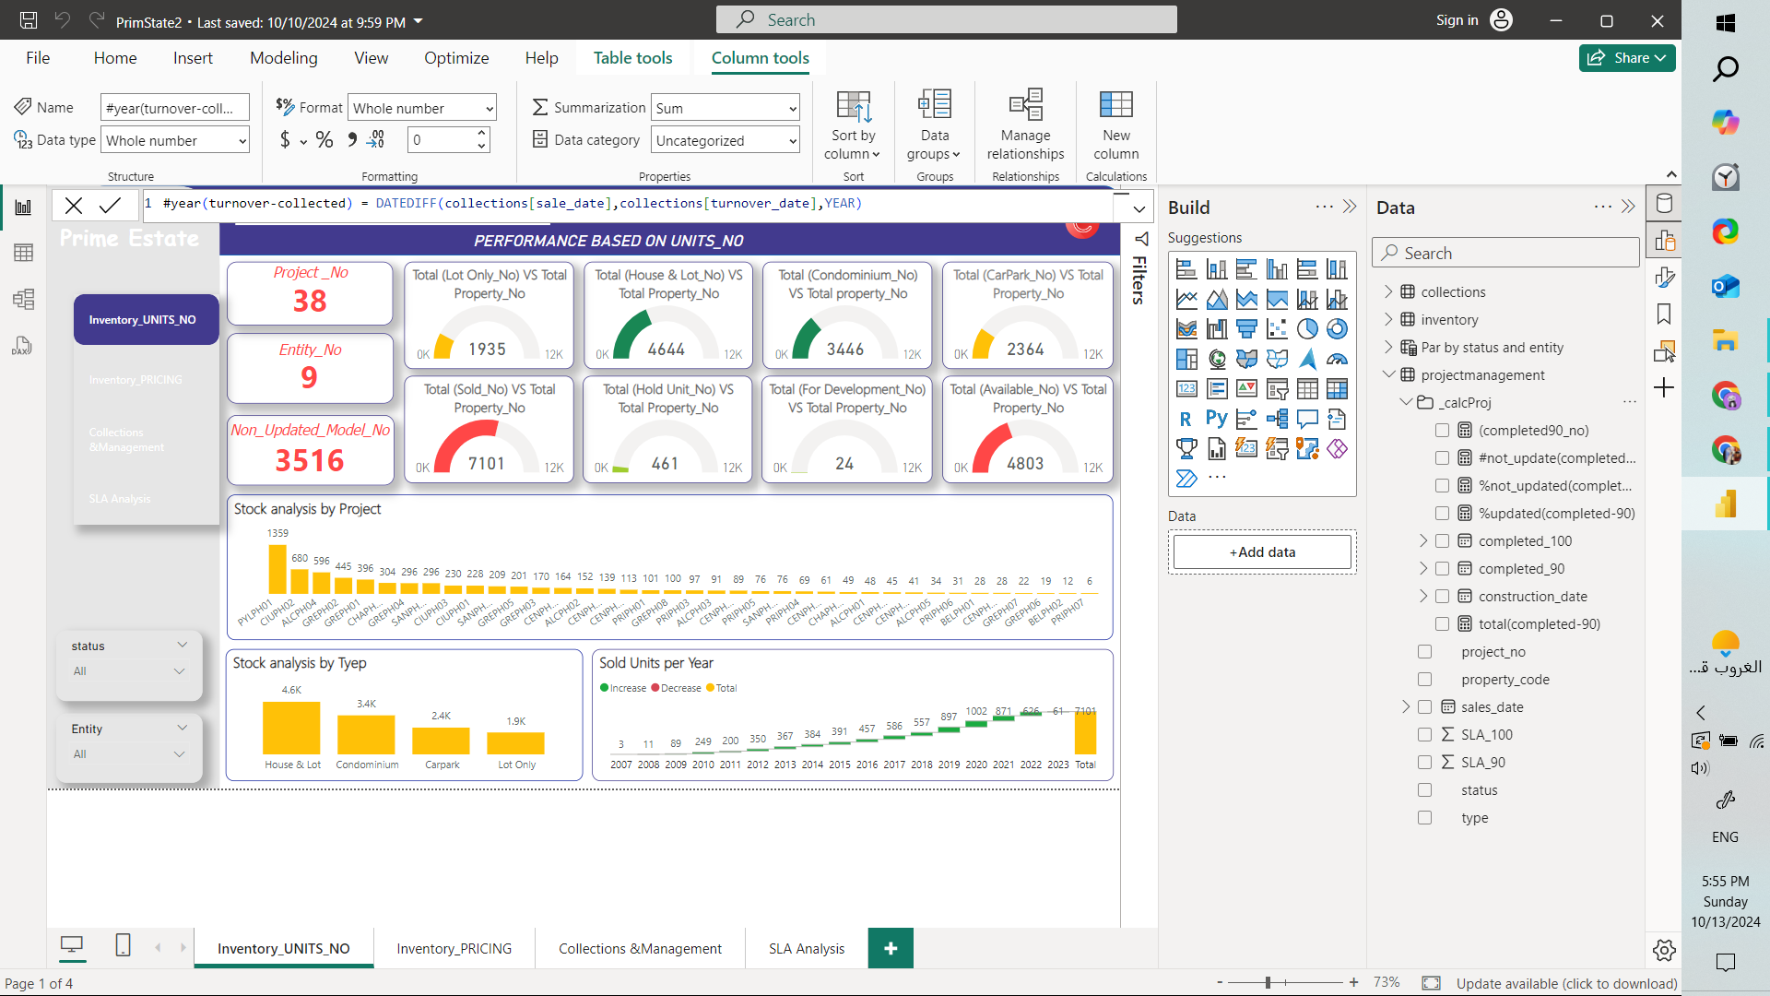
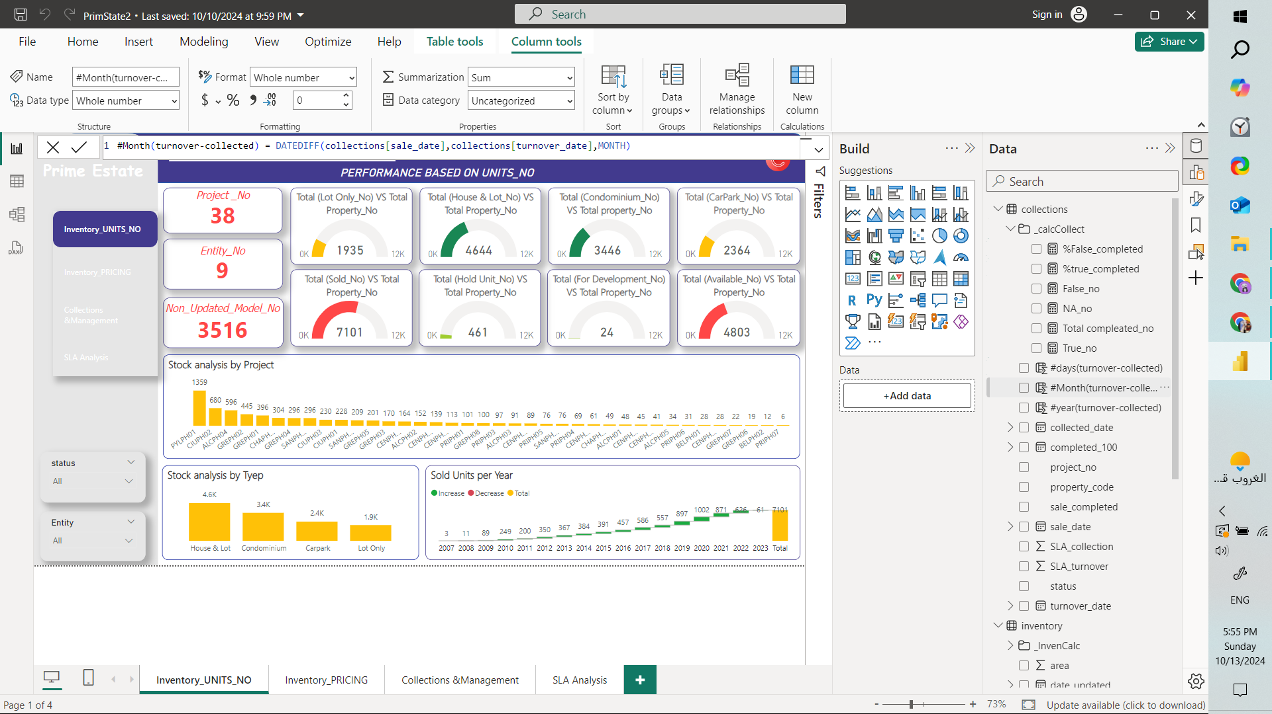
TEAM 2
AST
DAX
Creat New Columns

Slide 23
TEAM 2
AST
Insights
Properties under development are of the type:Lot Only , House & Lot
The type (House & Lot) achieved the highest recorded start date of the sale and is also the most available type with us.
The average transfer fee is around 6000 for Condominium type, while the average area is 46 m2. Despite this, this type is not one of the best-selling types.
The most expensive type is (House & Lot) while the most profitable type is (Condominium) with a difference between cost and price of about 400 million.
The most recorded type of completed sales is: Lot Only

Slide 24
TEAM 2
AST
Insights
The ownership percentage of uncompleted sales is higher than the percentage of completed sales.
Average number of years between turnover date and collection date
0 to 2
The least recorded type of completed sales is (House & Lot) Although it is the one that has the most recorded start date of the sale.
All properties are completed by 90%
The worst average SLA compliance rates were on turnover dates and collection dates.

Slide 25

Collaborate on a Whiteboard
Data Cleaning
Data Visualization
Presintation
Find Datasets
Analysis

Slide 26

Thank You

